Slide 1
Week 4 Notes
PHY495: Hoop Never Misses

Slide 2
What I’ve Done
Tried to optimize the angle of the backboard for a number of different shots

Slide 3
What Worked

Slide 4
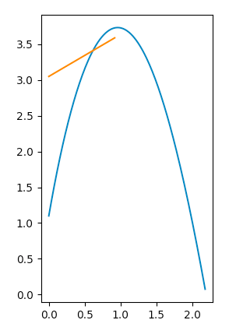
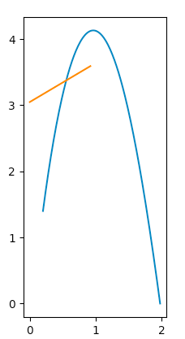
What Didn’t Work
Initially I ran into a problem where the ball was hitting the “wrong” side of the backboard – I fixed this by comparing the angle of the shot as it was hitting the backboard to the angle of the backboard

Slide 5
Where am I Stuck

Slide 6
What Next?
Figure out energy lost by hitting the backboard (I’m just going to keep putting this in the slides, so I don’t forget)

Slide 7
Sources

